Slide 1

Personal Expense Tracker and Analysis System
PYTHON PROJECT REVIEW
STUDENT NAME
Shibam Mitra
Student Code
BWU/MCA/26/028
DEPARTMENT
CSS
A Python application for recording daily expenses and analysing spending patterns with Pandas and Matplotlib
SUBJECT NAME
Problem Solving Using Python
SUBJECT CODE
MCA17400
Notes:
Introduce the project title and team. Replace the bracketed placeholders with the student names, roll numbers, department, subject name and subject code before presenting.

Slide 2



Introduction
Knowing where money goes is the first step to managing it. Many students and young professionals track expenses in notebooks or from memory, so they rarely see their real spending pattern.
Record
Date, category, amount and description for every expense
This project is a Python application that records daily expenses by category, stores them in files, and uses Pandas and Matplotlib to analyse and visualise spending. A web interface with user accounts lets each person work in a browser such as Safari.
Analyse
Totals, averages, highest and lowest spending with Pandas
Visualise
Python
Pandas
Matplotlib
Flask
Bar, pie, line and histogram charts with Matplotlib
Notes:
Set the context: most people track spending informally. This project gives them a structured, validated, visual alternative built with syllabus-level Python tools.

Slide 3




Problem Statement
Individuals lack a simple, structured way to record daily expenses and understand their spending pattern, which leads to overspending and weak financial planning.
Scattered records
Manual errors
No insight
Weak data control
Expenses sit in notebooks, messages or memory and are easily lost.
Adding totals by hand and typing wrong dates or amounts leads to mistakes.
There is no quick view by category, by month or of the largest expenses.
Third-party apps keep personal data on servers the user does not control.
Notes:
Read the statement, then walk through the four causes. Each one maps to a feature in the proposed system.

Slide 4
Objectives and Expected Outcomes
1
Record expenses with date, category, amount and description
Expected outcomes
2
Validate every input and reject invalid dates and amounts
A clear picture of where money goes
Consistent, error-free records
Visual reports generated in seconds
Private data for every user
3
Calculate total, monthly, category-wise and average spending using Pandas
4
Identify the highest and lowest expenses and sort records
5
Save records to files and retrieve them when the program starts
6
Present results as Matplotlib charts in a secure browser interface
Notes:
These six objectives come straight from the project brief. The conclusion slide returns to each one.

Slide 5



Scope of the Project
Coverage
Target users
Limitations
Daily expense entry in six categories
Overall and monthly analysis
Four chart types
Sign up and sign in with private data
Browser and terminal interfaces
Students managing allowance and fees
Young professionals tracking monthly spending
Families keeping simple household records
Anyone who wants analysis without spreadsheets
Single currency (₹)
No bank import or automatic capture
CSV files suit thousands of records, not millions
Local use only: no HTTPS or email reset
No budgets or alerts yet
Notes:
Be honest about limits: the system targets individual users, runs locally and stores data in files, which is right for a syllabus-level project.

Slide 6
Literature Review and Existing Systems
Existing approach | How it works | Limitations
Paper notebook or memory | Entries written by hand; totals added mentally | No analysis, easy to lose, no charts
Spreadsheets | Manual entry with user-built formulas and charts | No input validation; formulas break easily; setup effort
Mobile expense apps | Ready-made apps, often with cloud sync | Ads or subscriptions; data on third-party servers; fixed features
Bank and UPI statements | Automatic transaction history | Cash spending missing; fixed categories; hard to analyse by month
Gap addressed: a lightweight, validated system with analysis and charts built in, whose data stays on the user's own computer.
Notes:
Summarise the common ways people track expenses today and the gap this project fills.

Slide 7







Proposed System
Add expenses
Input validation
Spending analysis
Sort and search
Date, category, amount and description in one form
Rejects bad dates, amounts and categories
Totals, averages, highest and lowest with Pandas
Order by any field and find by description
Visual reports
File storage
User accounts
Monthly reports
Bar, pie, line and histogram charts
CSV records saved with safe writes
Sign up, sign in and private data per user
Pick any month for a focused summary
Notes:
Eight key features. The first five come from the project brief; accounts and monthly reports are extensions that make the system usable by more than one person.

Slide 8
Project Methodology
Incremental development: each module is built, tested and then integrated.
Requirements
Design
Implementation
Testing
Review
Features and users from the project brief
Modules, data files and screens
Python code written in VS Code
Unit and web tests on every module
Refine from results and feedback
Area | Technology | Area | Technology
Language | Python 3.10 or later | Data analysis | Pandas DataFrames
Visualisation | Matplotlib | Web framework | Flask with Jinja2 templates
Storage | CSV files and SQLite | Security | Hashed passwords, CSRF tokens
Tools | Visual Studio Code, Safari | Testing | unittest, 39 tests
Notes:
Incremental development: each module was written, tested with unit tests, then integrated. Tools are all free and taught at syllabus level.

Slide 9
Internal Structure: Architecture and Modules
Presentation layer
Browser interface
HTML templates and CSS
Terminal interface
Menu in cli.py
Application layer
Flask routes (app.py)
Sign in, dashboard, expenses, charts
Request guard
Session, CSRF, login required
Logic layer
validators.py
Input checks
analysis.py
Pandas calculations
report.py
Text reports
charts.py
Matplotlib charts
Data layer
users.db (SQLite)
Accounts, hashed passwords
user_N.csv files
One expense file per user
reports folder
Saved PNG charts
Notes:
A layered design. Each layer talks only to the one below it, which keeps the code easy to test and change.

Slide 10
Internal Structure: Data Flow and Database
User
1 Authenticate
2 Validate and store
3 Analyse
4 Charts and reports
D1 users.db
D2 user_N.csv (expense records)
users table (SQLite: data/users.db)
expense file (CSV: data/users/user_N.csv)
Field | Type | Rule
id | INTEGER | Primary key
name | TEXT | Required
email | TEXT | Unique
password_hash | TEXT | Salted hash
created_at | TEXT | Timestamp
Field | Type | Rule
id | integer | Primary key
date | YYYY-MM-DD | Not in future
category | text | One of six
amount | decimal | Greater than 0
description | text | Up to 60 chars
1 : N
Notes:
Top: level-1 data flow. Bottom: the two data stores. The users table is relational; expenses are kept in one CSV file per user, linked by the user id in the file name.

Slide 11
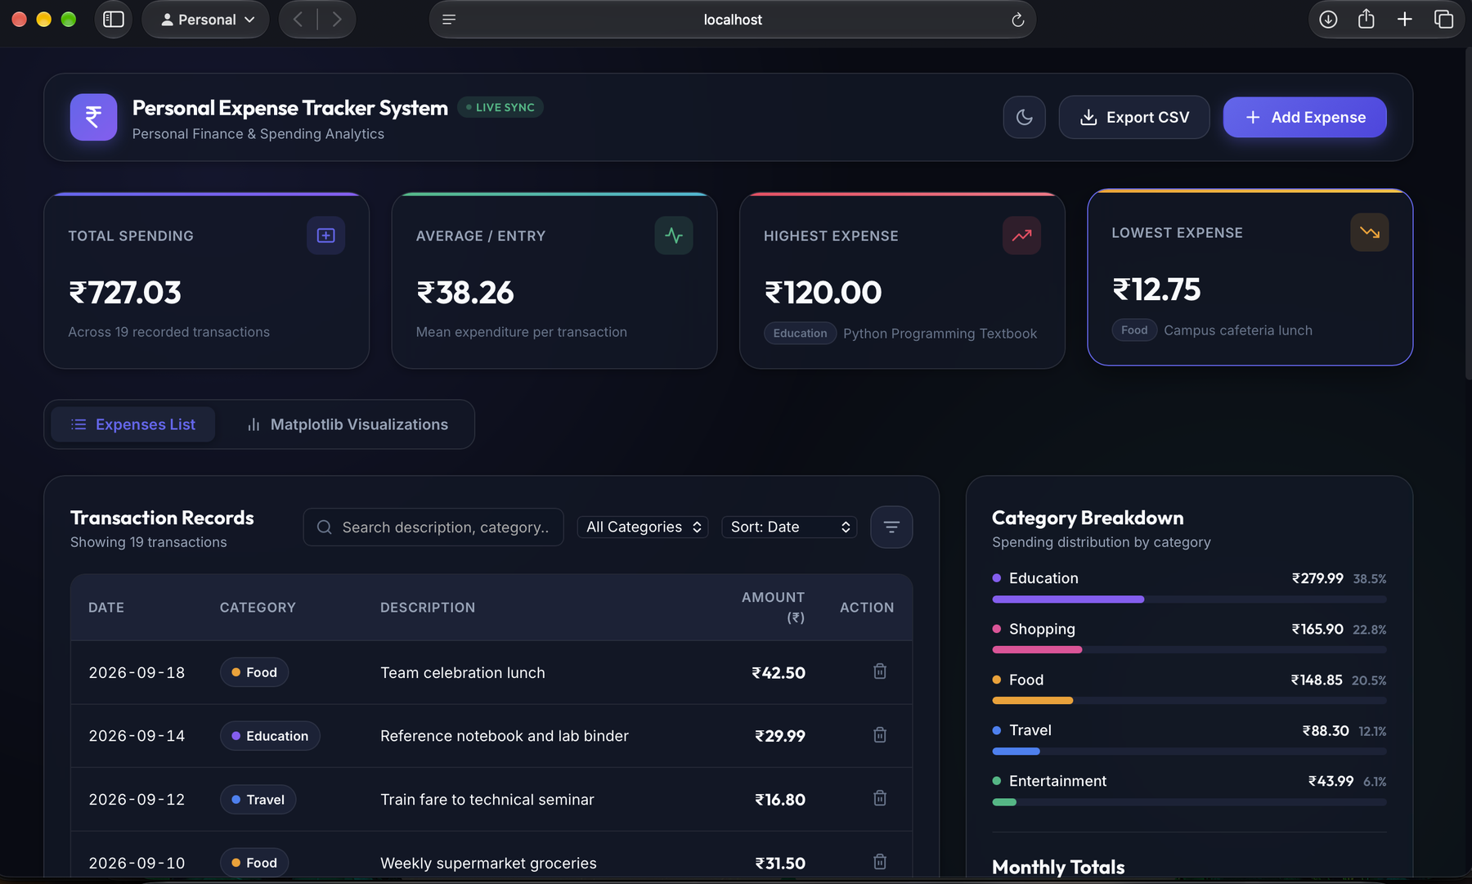
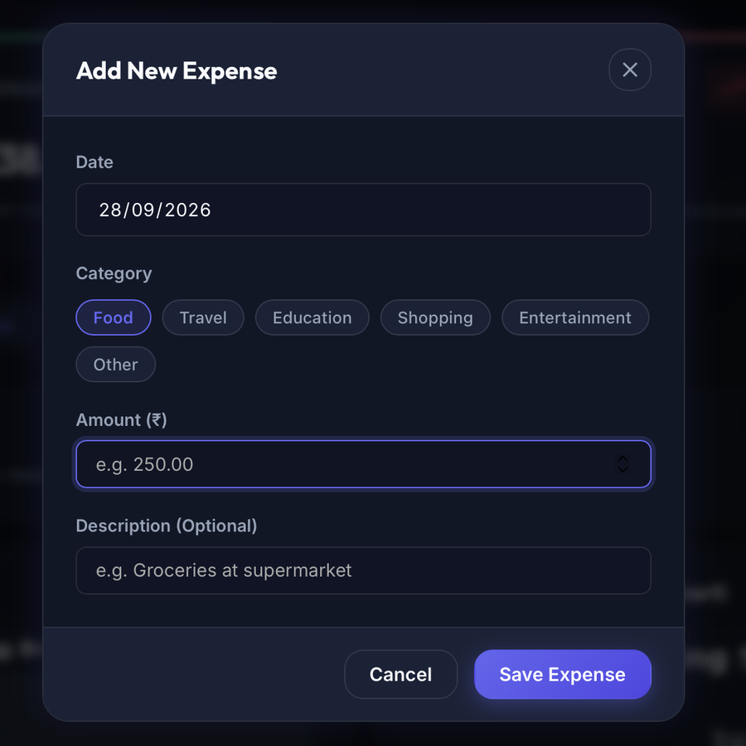
Implementation: Dashboard and Data Entry
Dashboard: summary cards, searchable and sortable transaction list, and category breakdown with monthly totals.
Add Expense: date, category, amount and description.
Notes:
Left: the dashboard with summary cards, searchable transaction list, category breakdown and monthly totals. Right: the Add Expense form with category chips.

Slide 12
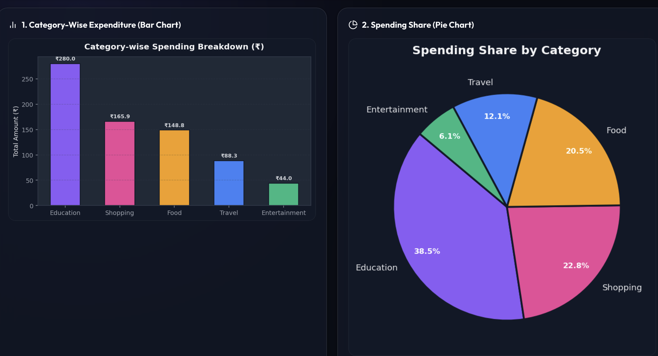
Implementation: Category Charts
Bar chart
Category-wise expenditure. Education is highest at ₹279.99, Entertainment lowest at ₹43.99.
Pie chart
Share of total spending: Education 38.5%, Shopping 22.8%, Food 20.5%, Travel 12.1%, Entertainment 6.1%.
Notes:
Matplotlib bar chart and pie chart generated from the same data as the dashboard. Education is the largest category at 38.5 percent.

Slide 13
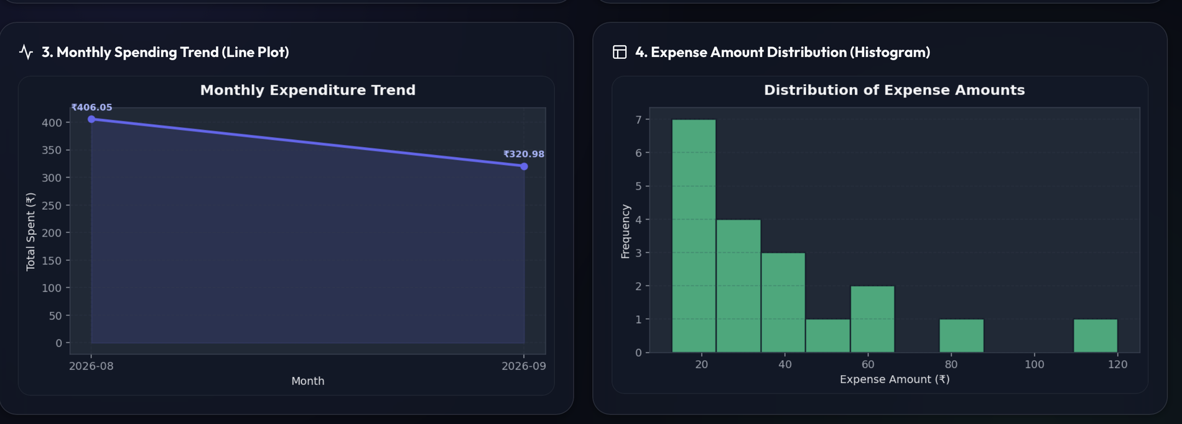
Implementation: Trend and Distribution Charts
Line plot: monthly spending fell from ₹406.05 in August to ₹320.98 in September.
Histogram: most expenses are small; one large purchase of about ₹120 stands out.
Notes:
The line plot shows monthly spending; the histogram shows how expense amounts are spread.

Slide 14
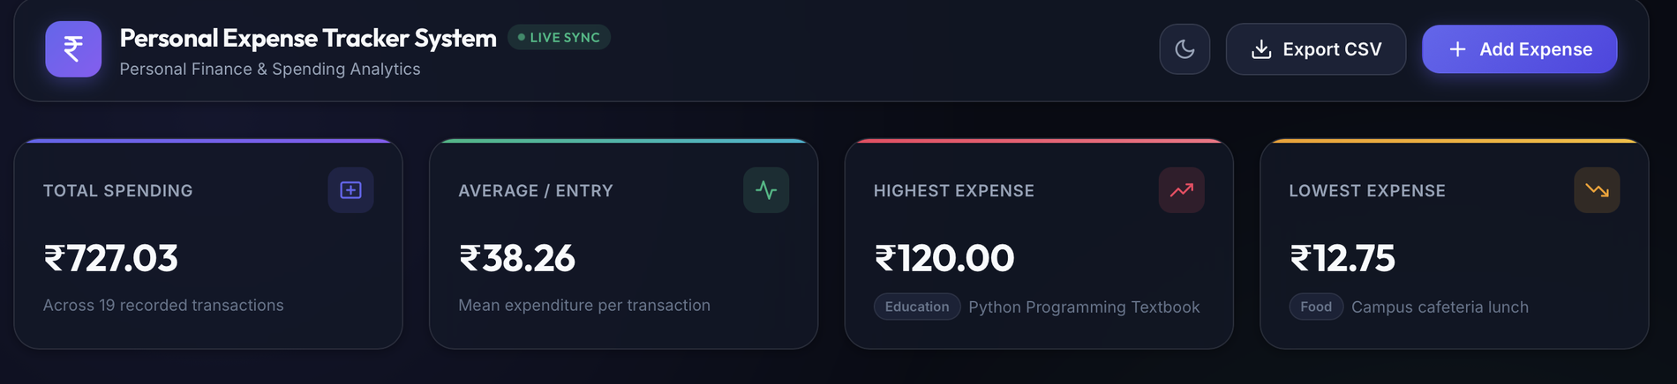
Testing and Results
19 transactions across 5 categories
Education leads with 38.5% of spending
39 of 39 automated tests pass
Analysis of 50,000 rows takes 15 ms
Test case | Input | Expected result | Result
Valid expense entry | 2026-03-14, Food, 249.50 | Record saved to CSV | Pass
Invalid or future date | 2025-02-30, tomorrow | Rejected with a message | Pass
Invalid amount | abc, 0, -5, nan | Rejected with a message | Pass
Unknown category | Gadgets | Rejected with a message | Pass
Corrupt rows in file | Bad date, negative amount | Rows skipped, rest loaded | Pass
Private page without sign-in | Open /expenses | Redirected to sign in | Pass
Notes:
Results are from the demonstration data shown in the dashboard: 19 transactions totalling 727.03 rupees. All 39 automated tests pass.

Slide 15





Conclusion and Future Scope
Future scope
Conclusion: objectives achieved
Monthly budgets with overspend alerts
Records expenses with date, category, amount and description
Rejects invalid dates, amounts and categories
Recurring expenses such as rent and subscriptions
Calculates total, monthly, category and average spending with Pandas
Finds highest and lowest expenses; sorts and searches records
Import bank statements; export reports to PDF and Excel
Saves records to files and loads them again
HTTPS deployment, password reset and a mobile app
Shows bar, pie, line and histogram charts in a browser dashboard
Notes:
Left: how each objective was met. Right: planned improvements. Close by inviting questions.

Slide 16
References
[1] McKinney, W. (2022). Python for Data Analysis (3rd ed.). O'Reilly Media.
[2] Hunter, J. D. (2007). Matplotlib: A 2D graphics environment. Computing in Science & Engineering, 9(3), 90-95.
[3] pandas development team. pandas documentation. https://pandas.pydata.org/docs/
[4] Matplotlib development team. Matplotlib documentation. https://matplotlib.org/stable/
[5] Pallets Projects. Flask documentation. https://flask.palletsprojects.com/
[6] Python Software Foundation. Python 3 documentation. https://docs.python.org/3/
[7] OWASP. Cross-Site Request Forgery Prevention Cheat Sheet. https://cheatsheetseries.owasp.org/
[8] OWASP. Password Storage Cheat Sheet. https://cheatsheetseries.owasp.org/
[9] Microsoft. Python in Visual Studio Code. https://code.visualstudio.com/docs/python/python-tutorial
[10] Sommerville, I. (2016). Software Engineering (10th ed.). Pearson.
Notes:
References are in APA style. Add any course textbooks or papers used in your own report.

